Slide 1
CS 402: DATA MINING AND WAREHOUSING

Slide 2
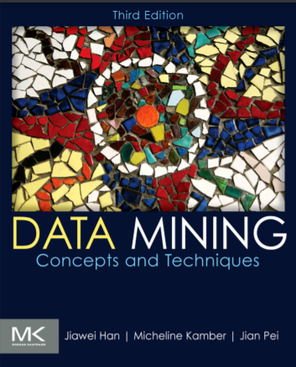

Slide 3
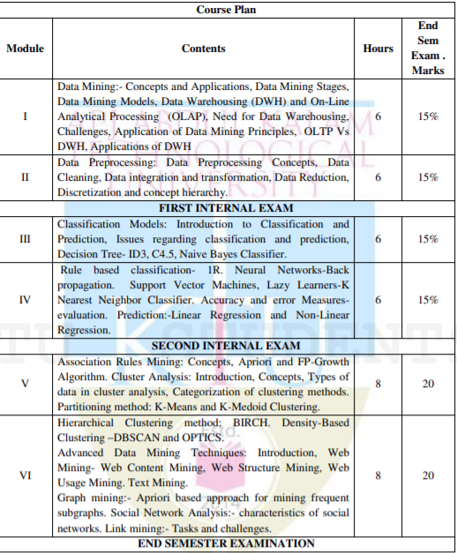

Slide 4
Module I
Data Mining:- Concepts and Applications
Data Mining Stages
Data Mining Models
Data Warehousing (DWH)
On-Line Analytical Processing (OLAP)
Need for Data Warehousing
Challenges, Application of Data Mining Principles
OLTP Vs DWH
Applications of DWH

Slide 5
Why Data Mining?
The Explosive Growth of Data: from terabytes to petabytes
Data collection and data availability
Automated data collection tools, database systems, Web, computerized society
Major sources of abundant data
Business: Web, e-commerce, transactions, stocks, …
Science: Remote sensing, bioinformatics, scientific simulation, …
Society and everyone: news, digital cameras, YouTube
We are drowning in data, but starving for knowledge!
“Necessity is the mother of invention”— Data mining—Automated analysis of massive data sets

Slide 6
What Is Data Mining?
Data mining (knowledge discovery from data)
Extraction of interesting (non-trivial, implicit, previously unknown and potentially useful) patterns or knowledge from huge amount of data
Alternative names
Knowledge discovery (mining) in databases (KDD), knowledge extraction, data/pattern analysis, data archeology, data dredging, information harvesting, business intelligence, etc.
Watch out: Is everything “data mining”?
Simple search and query processing
(Deductive) expert systems

Slide 7
What is (not) Data Mining
What is not Data Mining
Look up phone number in phone directory
Query a Web search engine for information about ”Amazon”
What is Data Mining
Certain names are more prevalent in certain US locations (OBrien, ORurke, OReilly... In Boston area)
Group together similar documents returned by search engine according to their context (e.g. Amazon rainforest, Amazon.com,)

Slide 8
Data Mining as the Evolution of Information Technology
Data Collection and Database Creation(1960s and earlier)
Database Management Systems(1970s to early 1980s)
Advanced Database Systems(mid-1980s to present)
& Advanced Data Analysis (late-1980s to present)
Future generation of Information Systems(present to future)

Slide 9
Data Mining: On What Kinds of Data?
Database-oriented data sets and applications
Relational database, data warehouse, transactional database
Advanced data sets and advanced applications
Data streams and sensor data
Time-series data, temporal data, sequence data (incl. bio-sequences)
Structure data, graphs, social networks and multi-linked data
Object-relational databases
Heterogeneous databases and legacy databases
Spatial data and spatiotemporal data
Multimedia database
Text databases
The World-Wide Web

Slide 10
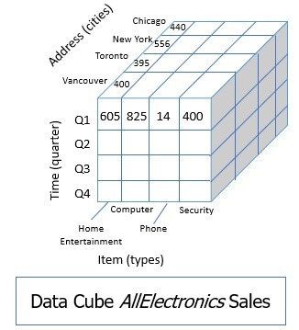

Slide 11
Module I
Data Mining:- Concepts and Applications
Data Mining Stages
Data Mining Models
Data Warehousing (DWH)
On-Line Analytical Processing (OLAP)
Need for Data Warehousing
Challenges, Application of Data Mining Principles
OLTP Vs DWH
Applications of DWH

Slide 12
Data Mining MODELS and tasks- What kinds of patterns can be mined?
Concept/Class Description: Characterization and Discrimination
Mining Frequent Patterns, Associations, and Correlations
Classification and Regression
Cluster Analysis
Outlier Analysis
Evolution Analysis

Slide 13
Concept/Class Description: Characterization and Discrimination
Data can be associated with classes or concepts
For example, in the AllElectronics store, classes of items for sale include computers and printers, and concepts of customers include bigSpenders and budgetSpenders.
It can be useful to describe individual classes and concepts in summarized, concise, and yet precise terms
Such descriptions of a class or a concept are called class/concept descriptions.

Slide 14
Characterization and Discrimination
Concept/Class Description are derived via
Data Characterization
Data Discrimination
Both data characterization and discrimination

Slide 15
Data Characterization
summarizing the data of the class under study (often called the target class)
typically collected by a database query
Example, to study the characteristics of software products whose sales increased by 10% in the last year
the data related to such products can be collected by executing an SQL query.
The output of data characterization can be presented in various forms like pie charts, bar charts, curves, multidimensional data cubes, and multidimensional tables etc.

Slide 16
Data Discrimination
comparison of the target class with one or a set of comparative classes (often called the contrasting classes)
The target and contrasting classes can be specified by the user, and the corresponding data objects retrieved through database queries.
Example, the user may like to compare the general features of software products whose sales increased by 10% in the last year with those whose sales decreased by at least 30% during the same period

Slide 17
Mining Frequent Patterns, Associations, and Correlations
Frequent patterns - Patterns that occur frequently in data
Frequent Itemset - set of items that frequently appear together in a transactional data set, such as milk and bread.
Frequent subsequence -A frequently occurring subsequence, such as the pattern that customers tend to purchase first a PC, followed by a digital camera, and then a memory card, is a (frequent) sequential pattern.
Mining frequent patterns leads to the discovery of interesting associations and correlations within data.

Slide 18
Association analysis
buys(X; “computer”)⇒buys(X; “software”) [support = 1%; confidence = 50%]
Where X is a variable representing a customer
A confidence, or certainty, of 50% means that if a customer buys a computer, there is a 50% chance that she will buy software as well.
A 1% support means that 1% of all of the transactions under analysis showed that computer and software were purchased together
This association rule involves a single attribute or predicate (i.e., buys) that repeats - single-dimensional association rules

Slide 19
Association analysis Contd….
age(X, “20…29”)^income(X, “20K….29K”)) ⇒buys(X, “CD player”) [support = 2%, confidence = 60%]
An association between more than one attribute, or predicate (i.e., age, income, and buys) - multidimensional association rule

Slide 20
Correlations
Association rules are discarded as uninteresting if they do not satisfy both a minimum support threshold and a minimum confidence threshold
Correlations are used to solve this problem

Slide 21
Classification and Regression
Classification
process of finding a model (or function) that describes and distinguishes data classes or concepts, for the purpose of being able to use the model to predict the class of objects whose class label is unknown.
The derived model may be represented in various forms, such as
classification (IF-THEN) rules,
decision trees,
mathematical formulae,
neural networks

Slide 22
Classification Example
Following are the examples of cases where the data analysis task is Classification :
A bank loan officer wants to analyse the data in order to know which customer (loan applicant) are risky or which are safe.
A marketing manager at a company needs to analyse to guess a customer with a given profile will buy a new computer.

Slide 23
Classification and Regression Contd..

Slide 24
Prediction
classification predicts categorical (discrete, unordered) labels,
Regression models predicts continuous-valued functions.
It is used to predict missing or unavailable numerical data values rather than class labels.

Slide 25
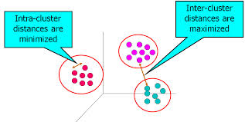
Cluster Analysis
Clustering is used if the class label is unknown
The objects are clustered or grouped based on the principle of maximizing the intraclass similarity and minimizing the interclass similarity.

Slide 26
Outlier Analysis
A database may contain data objects that do not comply with the general behaviour or model of the data. These data objects are outliers.
In some applications such as fraud detection, the rare events can be more interesting than the more regularly occurring ones.
The analysis of outlier data is referred to as outlier analysis or anomaly mining.

Slide 27
Evolution Analysis
Describes and models regularities or trends for objects whose behaviour changes over time.

Slide 28
Module I
Data Mining:- Concepts and Applications
Data Mining Models
Data Mining Stages
Data Warehousing (DWH)
On-Line Analytical Processing (OLAP)
Need for Data Warehousing
Challenges, Application of Data Mining Principles
OLTP Vs DWH
Applications of DWH

Slide 29
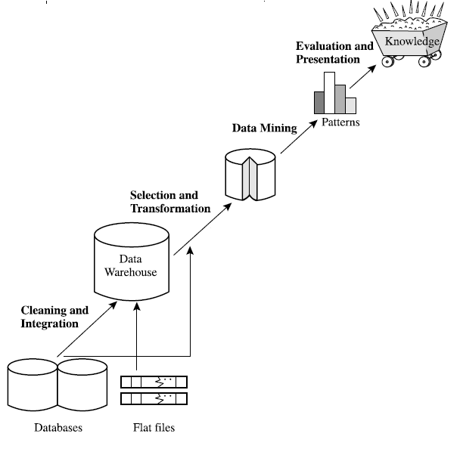
Knowledge Discovery (KDD) Process

Slide 30
Data Mining Stages
Data Cleaning: Data cleaning is defined as removal of noisy and irrelevant data from collection.
Cleaning in case of Missing values.
Cleaning noisy data, where noise is a random or variance error.
Cleaning with Data discrepancy detection and Data transformation tools.

Slide 31
Data Mining Stages
Data Integration: Data integration is defined as heterogeneous data from multiple sources combined in a common source (Data Warehouse).
Data integration using Data Migration tools.
Data integration using Data Synchronization tools.
Data integration using ETL(Extract-Load-Transformation) process.

Slide 32
Data Mining Stages
Data Selection: Data selection is defined as the process where data relevant to the analysis is decided and retrieved from the data collection.
Data selection using Neural network.
Data selection using Decision Trees.
Data selection using Naive Bayes.
Data selection using Clustering, Regression, etc.

Slide 33
Data Mining Stages
Data Transformation: Data Transformation is defined as the process of transforming data into appropriate form required by mining procedure.
Data Transformation is a two step process:
Data Mapping: Assigning elements from source base to destination to capture transformations.
Code generation: Creation of the actual transformation program.

Slide 34
Data Mining Stages
Data Mining: Data mining is defined as clever techniques that are applied to extract patterns potentially useful.
Transforms task relevant data into patterns.
Decides purpose of model using classification or characterization.

Slide 35
Data Mining Stages
Pattern Evaluation: Pattern Evaluation is defined as identifying strictly increasing patterns representing knowledge based on given measures.
Find interestingness score of each pattern.
Uses summarization and Visualization to make data understandable by user.

Slide 36
Data Mining Stages
Knowledge representation: Knowledge representation is defined as technique which utilizes visualization tools to represent data mining results.
Generate reports.
Generate tables.
Generate discriminant rules, classification rules, characterization rules, etc.

Slide 37
Applications of Data mining
Two popular applications
Business Intelligence
Web Search Engines

Slide 38
Module I
Data Mining:- Concepts and Applications
Data Mining Models
Data Mining Stages
Data Warehousing (DWH)
On-Line Analytical Processing (OLAP)
Need for Data Warehousing
Challenges, Application of Data Mining Principles
OLTP Vs DWH
Applications of DWH

Slide 39
A producer wants to know….
Which are our lowest/highest margin customers ?
Who are my customers and what products are they buying?
What is the most effective distribution channel?
What product prom- -otions have the biggest impact on revenue?
Which customers are most likely to go to the competition ?
What impact will new products/services
have on revenue and margins?

Slide 40
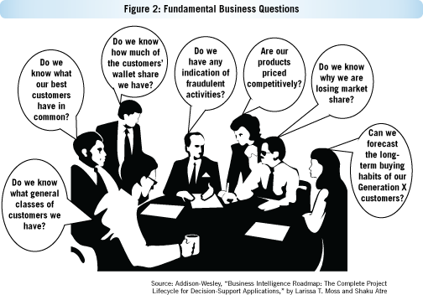
Need for Data Warehouse

Slide 41
What is Data Warehouse?
Defined in many different ways, but not rigorously.
A decision support database that is maintained separately from the organization’s operational database
Support information processing by providing a solid platform of consolidated, historical data for analysis.
“A data warehouse is a subject-oriented, integrated, time-variant, and nonvolatile collection of data in support of management’s decision-making process.”
Data warehousing:
The process of constructing and using data warehouses

Slide 42
Data Warehouse—Subject-Oriented
Organized around major subjects, such as customer, product, sales
Focusing on the modeling and analysis of data for decision makers, not on daily operations or transaction processing
Provide a simple and concise view around particular subject issues by excluding data that are not useful in the decision support process

Slide 43
Data Warehouse—Subject-Oriented Contd…
OLTP Applications
Data Warehouse Subject
Equity
Plans
Shares
Customer
financial
information
Insurance
Savings
Loans

Slide 44
Data Warehouse—Integrated
Constructed by integrating multiple, heterogeneous data sources
relational databases, flat files, on-line transaction records
Data cleaning and data integration techniques are applied.
Ensure consistency in naming conventions, encoding structures, attribute measures, etc. among different data sources
E.g., Hotel price: currency, tax, breakfast covered, etc.
When data is moved to the warehouse, it is converted.

Slide 45
Data Warehouse—Integrated Contd…
Savings
Current
accounts
Loans
Customer
OLTP Applications
Data Warehouse

Slide 46
Data Warehouse—Time Variant
The time horizon for the data warehouse is significantly longer than that of operational systems
Operational database: current value data
Data warehouse data: provide information from a historical perspective (e.g., past 5-10 years)
Every key structure in the data warehouse
Contains an element of time, explicitly or implicitly
But the key of operational data may or may not contain “time element”

Slide 47
Data Warehouse—Nonvolatile
A physically separate store of data transformed from the operational environment
Operational update of data does not occur in the data warehouse environment
Does not require transaction processing, recovery, and concurrency control mechanisms
Requires only two operations in data accessing:
initial loading of data and access of data

Slide 48
Data Warehouse—Nonvolatile Contd…
Operational
Warehouse
Load
Insert
Update
Delete
Read
Read

Slide 49
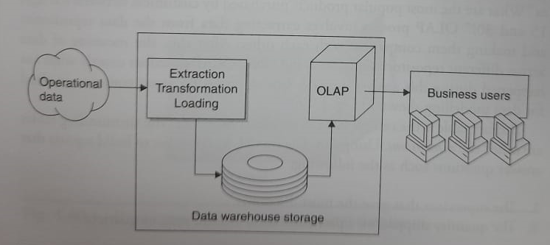
OLAP(On Line Analytical Processing)
OLAP Technology uses data warehouses for online analysis , providing quick responses to quires.
Data warehousing and OLAP

Slide 50
OLTP vs OLAP

Slide 51
A Multidimensional Data Model
Data warehouses and OLAP tools are based on a multidimensional data model.
This model views data in the form of a data cube.
an n-Dimensional base cube is called a base cuboid
The top most 0-D cuboid, which holds the highest-level of summarization, is called the apex cuboid
The lattice of cuboids forms a data cube

Slide 52
Cube: A Lattice of Cuboids
all
0-D(apex) cuboid
time
item
location
supplier
1-D cuboids
time,location
item,location
location,supplier
time,item
2-D cuboids
time,supplier
item,supplier
time,location,supplier
3-D cuboids
time,item,location
time,item,supplier
item,location,supplier
4-D(base) cuboid
time, item, location, supplier

Slide 53
What is a data cube ?
A data cube allows data to be modelled and viewed in multiple dimensions.
It is defined by dimensions and facts.

Slide 54
From Tables and Spreadsheets to Data Cubes

Slide 55
From Tables and Spreadsheets to Data Cubes Contd….

Slide 56
From Tables and Spreadsheets to Data Cubes Contd….

Slide 57
Stars, Snowflakes, and Fact Constellations: Schemas for Multidimensional Databases
Star schema
A fact table in the middle connected to a set of dimension tables
Snowflake schema
A refinement of star schema where some dimensional hierarchy is normalized into a set of smaller dimension tables, forming a shape similar to snowflake
Fact constellations
Multiple fact tables share dimension tables, viewed as a collection of stars, therefore called galaxy schema or fact constellation

Slide 58
Star Schema Example
Time
time_key
day
day_of_the_week
month
quarter
year
Item
item_key
item_name
brand
type
supplier_type
Sales Fact Table
Time_key
Item_key
Branch_key
Branch
Location_key
Location
branch_key
branch_name
branch_type
Unit_sold
location_key
street
city
province_or_street
country
Euros_sold
Avg_sales
Measures

Slide 59
Snowflake schema Example
Supplier
Sales Fact Table
supplier_key
supplier_type
Time
time_key
day
day_of_the_week
month
quarter
year
Time_key
Item_key
Branch_key
Item
Location_key
item_key
item_name
brand
type
supplier_key
Unit_sold
City
Euros_sold
city_key
city
province_or_street
country
Avg_sales
Branch
branch_key
branch_name
branch_type
Location
Measures
location_key
street
city_key

Slide 60
Fact constellations Schema
Time
Shipping Fact Table
time_key
day
day_of_the_week
month
quarter
year
Time_key
Item
Item_key
item_key
item_name
brand
type
supplier_key
shipper_key
from_location
Sales Fact Table
to_location
Time_key
Euros_sold
Branch
Item_key
unit_shipped
branch_key
branch_name
branch_type
Branch_key
Location_key
Location
location_key
street
city
Province/street
country
Unit_sold
Euros_sold
shipper
Avg_sales
60
shipper_key
shipper_name
location_key
shipper_type
Measures

Slide 61
DMQL: Language Primitives
Cube Definition (Fact Table)
define cube <cube_name> [<dimension_list>]: <measure_list>
Dimension Definition (Dimension Table)
define dimension <dimension_name> as (<attribute_or_subdimension_list>)
Special Case (Shared Dimension Tables)
First time as “cube definition”
define dimension <dimension_name> as <dimension_name_first_time> in cube <cube_name_first_time>

Slide 62
Defining a Star Schema in DMQL
define cube sales_star [time, item, branch, location]:
dollars_sold = sum(sales_in_dollars),
avg_sales = avg(sales_in_dollars),
units_sold = count(*)
define dimension time as
(time_key, day, day_of_week, month, quarter, year)

Slide 63
define dimension item as
(item_key, item_name, brand, type, supplier_type)
define dimension branch as
(branch_key, branch_name, branch_type)
define dimension location as
(location_key, street, city, province_or_state, country)

Slide 64
Defining a Snowflake Schema in DMQL
define cube sales_snowflake [time, item, branch, location]:
dollars_sold = sum(sales_in_dollars),
avg_sales = avg(sales_in_dollars),
units_sold = count(*)

Slide 65
define dimension time as
(time_key, day, day_of_week, month, quarter, year)
define dimension item as
(item_key, item_name, brand, type, supplier(supplier_key, supplier_type))
define dimension branch as
(branch_key, branch_name, branch_type)
define dimension location as
(location_key, street, city(city_key, province_or_state, country))

Slide 66
Defining a Fact Constellation in DMQL
define cube sales [time, item, branch, location]:
dollars_sold = sum(sales_in_dollars), avg_sales = avg(sales_in_dollars),
units_sold = count(*)
define dimension time as (time_key, day, day_of_week, month, quarter, year)
define dimension item as (item_key, item_name, brand, type, supplier_type)
define dimension branch as (branch_key, branch_name, branch_type)
define dimension location as (location_key, street, city, province_or_state, country)

Slide 67
Defining a Fact Constellation in DMQL
define cube shipping [time, item, shipper, from_location, to_location]:
dollar_cost = sum(cost_in_dollars), unit_shipped = count(*)
define dimension time as time in cube sales
define dimension item as item in cube sales
define dimension shipper as (shipper_key, shipper_name, location as location in cube
sales, shipper_type)
define dimension from_location as location in cube sales
define dimension to_location as location in cube sales

Slide 68
Concept Hierarchy
A concept hierarchy defines a sequence of mappings from a set of low-level concepts to higher-level, more general concepts.

Slide 69
OLAP Operations
Roll-up (Drill-up)
Drill-down
Slice and dice
Pivot (rotate)

Slide 70
Roll-Up
This operation performs aggregation on a data cube in any of the following way:
By climbing up a concept hierarchy for a dimension
By dimension reduction.

Slide 71
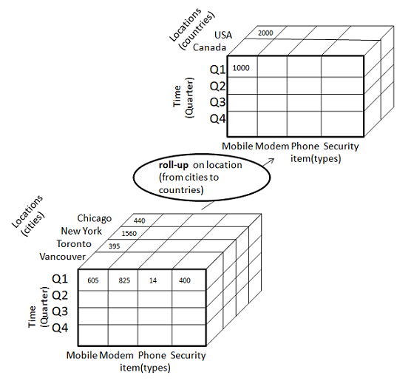
Roll-Up Example
The roll-up operation is performed by climbing up a concept hierarchy for the dimension location.
Initially the concept hierarchy was "street < city < province < country".
On rolling up the data is aggregated by ascending the location hierarchy from the level of city to level of country.
The data is grouped into cities rather than countries.
When roll-up operation is performed then one or more dimensions from the data cube are removed.

Slide 72
Drill-down
Drill-down operation is reverse of the roll-up. This operation is performed by either of the following way:
By stepping down a concept hierarchy for a dimension.
By introducing new dimension.

Slide 73
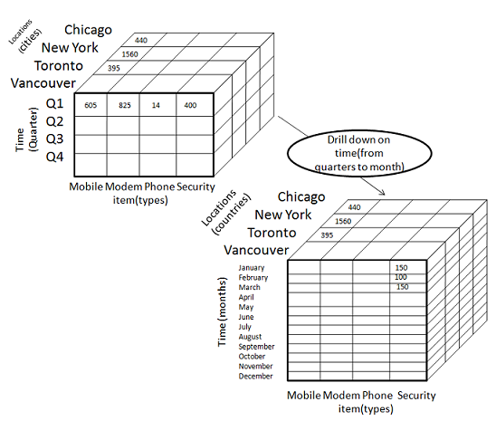
Drill-down Example
The drill-down operation is performed by stepping down a concept hierarchy for the dimension time.
Initially the concept hierarchy was "day < month < quarter < year."
On drill-up the time dimension is descended from the level quarter to the level of month.
When drill-down operation is performed then one or more dimensions from the data cube are added.
It navigates the data from less detailed data to highly detailed data.

Slide 74
Slice
The slice operation performs selection of one dimension on a given cube and give us a new sub cube.

Slide 75
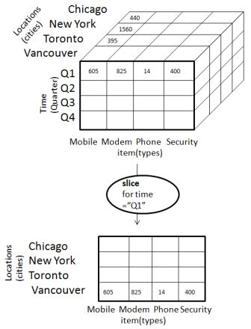
Slice Example
The Slice operation is performed for the dimension time using the criterion time ="Q1".
It will form a new sub cube by selecting one or more dimensions.

Slide 76
Dice
The Dice operation performs selection of two or more dimension on a given cube and give us a new subcube.

Slide 77
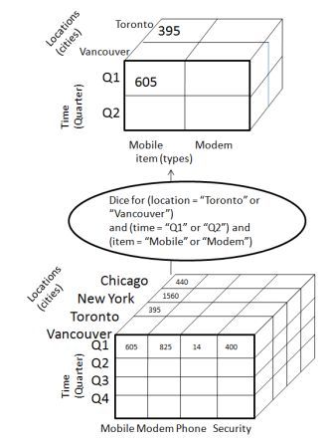
Dice Example
The dice operation on the cube based on the following selection criteria that involve three dimensions.
(location = "Toronto" or "Vancouver")
(time = "Q1" or "Q2")
(item =" Mobile" or "Modem").

Slide 78
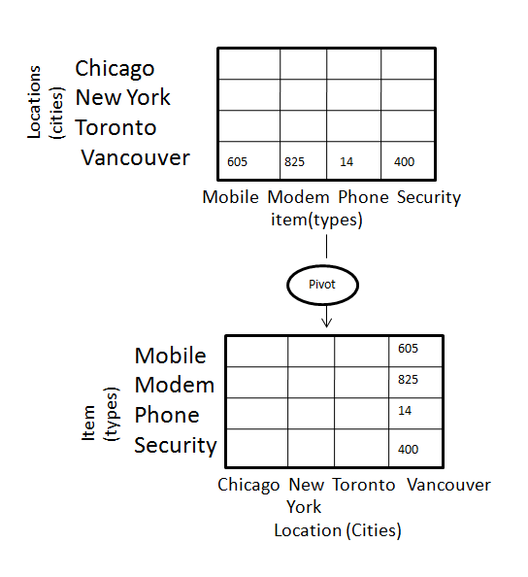
Pivot
The pivot operation is also known as rotation.
It rotates the data axes in view in order to provide an alternative presentation of data.

Slide 79
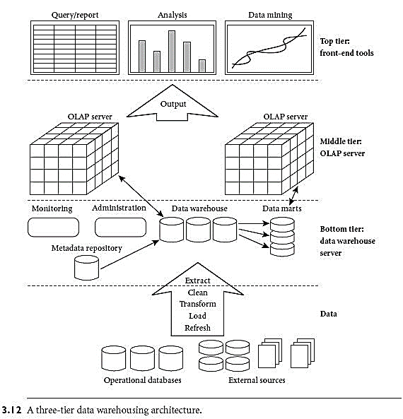
A three-tier data warehousing architecture

Slide 80
A three-tier data warehousing architecture – Bottom Tier
The bottom tier is a warehouse database server that is almost always a relational database system.
Back-end tools and utilities are used to feed data into the bottom tier from operational databases or other external sources
These tools and utilities perform data extraction, cleaning, transformation ,load and refresh functions to update the data warehouse
The data are extracted using application program interfaces known as gateways.
A gateway is supported by the underlying DBMS and allows client programs to generate SQL code to be executed at a server

Slide 81
A three-tier data warehousing architecture – Bottom Tier Contd…
This tier also contains a metadata repository,
which stores information about the data warehouse and its contents.

Slide 82
A three-tier data warehousing architecture – Middle Tier
The middle tier is an OLAP server
implemented using either
a relational OLAP (ROLAP) model
multidimensional OLAP (MOLAP) model
ROLAP is an extended relational DBMS that maps operations on multidimensional data to standard relational operations
MOLAP is a special-purpose server that directly implements multidimensional data and operations

Slide 83
A three-tier data warehousing architecture – Top Tier
The top tier is a front-end client layer,
contains query and reporting tools, analysis tools, and/or data mining tools (e.g., trend analysis, prediction, and so on).

Slide 84
Data Warehouse Back-End Tools and Utilities
Data warehouse systems use back-end tools and utilities to populate and refresh their data
Data extraction, which typically gathers data from multiple, heterogeneous, and external sources.
Data cleaning, which detects errors in the data and rectifies them when possible
Data transformation, which converts data from legacy or host format to warehouse format
Load, which sorts, summarizes, consolidates, computes views, checks integrity, and builds indices and partitions
Refresh, which propagates the updates from the data sources to the warehouse

Slide 85
Metadata Repository
which stores information about the data warehouse and its contents.
A metadata repository should contain the following:
A description of the structure of the data warehouse
warehouse schema, view, dimensions, hierarchies, and derived data definitions, as well as data mart locations and contents
Operational metadata,
data lineage (history of migrated data and the sequence of transformations applied to it)
currency of data (active, archived, or purged),
monitoring information (warehouse usage statistics, error reports, and audit trails)

Slide 86
Metadata Repository Contd…
The algorithms used for summarization
The mapping from the operational environment to the data warehouse
source databases and their contents,
gateway descriptions, data partitions, data extraction,
cleaning, transformation rules and defaults,
data refresh and purging rules, and security (user authorization and access control)

Slide 87
Metadata Repository Contd…
Data related to system performance
indices and profiles that improve data access and retrieval performance
rules for the timing and scheduling of refresh, update, and replication cycles
Business metadata,
Business terms and definitions, data ownership information, and charging policies

Slide 88
Data Mart
A subset of a data warehouse that supports the requirements of a particular department or business function.
Characteristics include:
Do not normally contain detailed operational data unlike data warehouses.
May contain certain levels of aggregation
Depending on the source of data, data marts can be categorized as
Independent data mart
Dependent data mart

Slide 89

Dependent Data Mart
Flat Files
Sourced directly from enterprise data warehouses.
Operational Systems
Marketing
Marketing
Sales
Finance
Human Resources
Sales
Data
Warehouse
Finance
Data Marts
External Data

Slide 90
Independent Data Marts
Data captured from one or more operational systems or external information providers, or from data generated locally within a particular department or geographic area
Operational Systems
Flat Files
Data Mart
Sales or Marketing
External Data

Slide 91
OLAP Server Architectures
Relational OLAP (ROLAP)
Use relational or extended-relational DBMS to store and manage warehouse data and OLAP middle ware to support missing pieces
Include optimization of DBMS backend, implementation of aggregation navigation logic, and additional tools and services
greater scalability
Multidimensional OLAP (MOLAP)
Array-based multidimensional storage engine (sparse matrix techniques)
fast indexing to pre-computed summarized data
Hybrid OLAP (HOLAP)
User flexibility, e.g., low level: relational, high-level: array
Specialized SQL servers
specialized support for SQL queries over star/snowflake schemas

Slide 92
Applications of Data Warehouse
Information processing
Analytical Processing
Data mining

Slide 93
Thank you

